Slide 1

Software Project Management
Risk Management

Slide 2
Risk
Risk is an uncertain event that could have a positive or negative outcome
Risk itself is not really a bad thing - it’s the impact of the risk
Positive risks are called risk opportunities

Slide 3
Risk
For Example: Using a worker with less experience in order to save money.
The risk is that less experienced worker may do a bad job
The reward is that the worker will cost less than a more experienced worker and save project some cash

Slide 4
What is Project Risk Management?
Project risk management is actively managing the risks on your project
The goal of risk management is to be more proactive and less reactive

Slide 5
Why Risk Management
A project manager’s work should not focus on dealing with problems; it should focus on preventing them.
How would it feel to say, “No problem; we anticipated this, and we have a plan in place that will resolve it”.
Performing risk management helps prevent many problems and helps make other problems less likely

Slide 6
Two Types of Risks
Pure Risks These risks have no upside, only a downside e.g., Loss of Life, Natural Disaster, etc
Business Risks/ Speculative Risks These risks are the calculated risks e.g., Selecting Team, Technology, Budget, Schedule, etc

Slide 7
Business Risks
Employee quits
Inadequate budget for completing the project
Unrealistic scope expectations
A project team needs time to learn new technology
Unclear requirements
The project manager, sponsor, or other stakeholders are not as knowledgeable as you would hope

Slide 8
Business Risks
Always Remember:
Business risks are not bad; it’s their impact that has the potential to hurt you or the project
Every software project has risks

Slide 9
Risks to Software Projects
Delays in your project shorten the window for demand of your software.
Your programmers’ ability to learn new programming languages and adapt to new development environments.
Your stakeholders may have a tough time explaining what they want the project deliverable to be.
Because programmers are in demand, a programmer could leave your project team.
If your project has never been attempted before, you risk suffering from the first-time, first-use penalty.

Slide 10
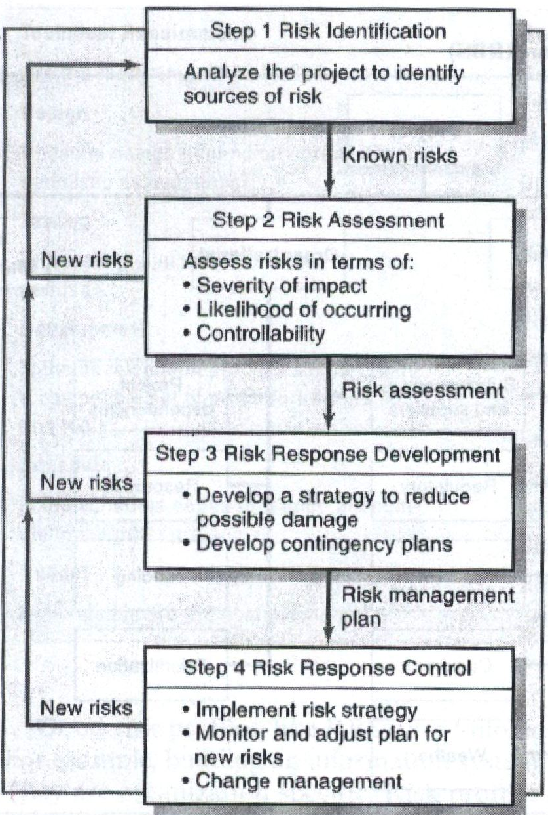
Risk Management Process:

Slide 11
Risk Tolerance
Depending on the project, conditions and the potential for loss or reward, stakeholders will have different tolerance for risks.
Your willingness to invest in a riskier venture, and the amount you’re comfortable investing, describe your utility function
A person’s willingness to accept risks is called his or her “Utility Function”
You, your project team, and the key stakeholders will be happy to accept some risks and will refuse to accept others
With higher project priority, stakeholders have lower utility function.

Slide 12
Identifying Risks
The method you use to gather information and identify risks is not as important as the fact that you are obtaining as much information as possible.
Brainstorming
Arrange meeting(s) of all stakeholders and create a list of all possible risks
Delphi Method
This allows stakeholders to anonymously offer their input into identifying risks. They can send their suggestions via e-mail to one person who will then consolidate the information into one document – without naming the source

Slide 13
Identifying Risks
Note:
Emphasize on quantity - More is better
If a risk is not identified, it is accepted by default

Slide 14
Risk Analysis
Qualitative Analysis Process of creating a risk ranking based on all the identified risks within the project. (you’re describing the qualities of the risks)
Quantitative Analysis Process of measuring your risk exposure. (gives a quantity, usually a number, and often cost of the impacts of those risks)

Slide 15
Difference:
Qualitative risk analysis is more subjective in nature, based on facts and figures from previous experience.
However, quantitative risk analysis produces statistical numbers for each of the risks, thus making it easier to prioritize them.

Slide 16
Qualitative Risk Analysis
Process of creating a risk ranking based on all the identified risks within the project.
Ranking Risks:
Ordinal: This assessment simply ranks risks as high, medium, or low.
Cardinal: When you use this ranking system, you assign scores with hard numbers, like 1,2,3,...

Slide 17
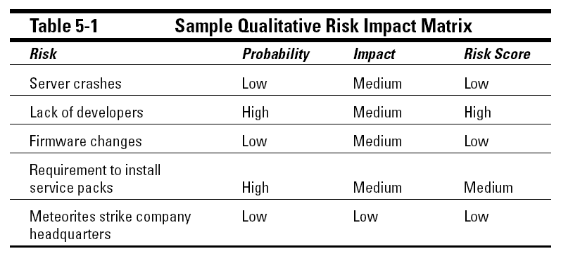
Qualitative Risk Analysis
You must determine which risks are small enough to accept and which risks need more analysis.
Usually risks with a medium or greater ranking qualify for quantitative analysis.

Slide 18
Quantitative Risk Analysis
Process of measuring your risk exposure.
You need to do more, which may require extra time and cost:
Interviews
Set up Prototypes
Expert analysis
Set up simulations

Slide 19
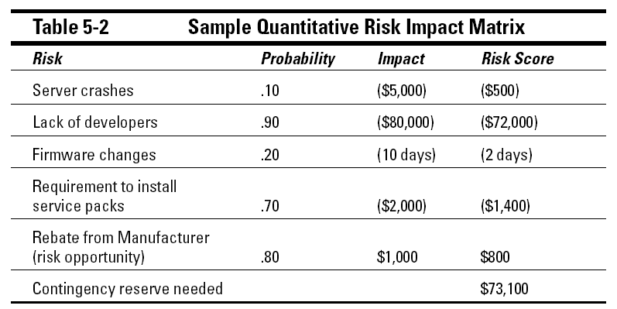
Quantitative Risk Analysis

Slide 20
Risk Response Plan
The risk response plan is a document:
details the identified risks within a project, their impact, and their associated costs,
and then identifies how the project team will respond to the risks
In addition, the risk response plan nods to the process of risk management
Risk identification, the first step of risk management, is an iterative process that happens throughout the project —not just at the beginning

Slide 21
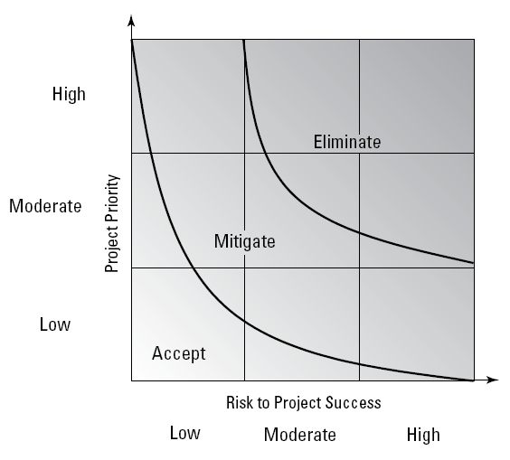
Plan Risk Responses
Your risk response
plan helps you see that
not all risks need to be
eliminated.
Avoiding Risks
Transferring Risks
Mitigating Risks
Accepting Risks

Slide 22
Risk Response: Avoiding
Often the most desirable risk response is to just avoid the risk.
Change a project plan to avoid risk
Use an established approach to software development rather than a new model
Hire experts to consult the project team during the development process
Spend additional time with the project stakeholders to clarify all project objectives and requirements

Slide 23
Risk Response: Transferring
Transference means that the risk doesn’t go away. It’s just someone else’s responsibility now.
Hire experts to complete a portion of the project work
Demand warranties from vendors
Bring in consultants to test units and builds of your software
Transferring risks introduces a whole new set of risks that you and your team must identify, analyze, and respond to.

Slide 24
Risk Response: Mitigating
Risk mitigation is about reducing the impact and/or the probability of risk.
When you implement risk mitigation strategies, you typically examine the risks with medium to high scores for risk mitigation opportunities
Basically you attempt to answer questions like, “How can the impact, the probability, or both be reduced to a level that we can live with?”

Slide 25
Risk Response: Accepting
When you accept certain risks, either the risks are so low that the project can live with them,
or the risks are inevitable but the project must move forward anyway
Usually, risk acceptance is for the smaller, puny risks that have a very low probability, a very low impact, or both.

Slide 26
Risks Database
You may create a database or register to keep track of
each previously identified risk,
identify and document new risks, and
track the response plans for each risk.
There may even be instances where
a risk that you documented at the start of the project is no longer valid;
you should make revisions to your risk management plan to address this change.

Slide 27
Control Risks
Examining Risk Responses and Impacts
The project team and the project manager should determine when the risk response should be implemented.
Risk Threshold: The line of demarcation that signals that a risk is about to come into play and that some response should happen. (e.g., deadline, amount of work, etc)
Risk Trigger: A trigger is an event within the project that triggers a preplanned response to the identified risk. (e.g., missed deadline, incomplete work, etc)

Slide 28
Control Risks:
Risk Trigger: An indication that a risk has occurred or is about to occur. Triggers are defined in the risk identification process and watched in the risk monitoring and control process. Example: In a project involving new technology which the team has not worked on the mitigation plan would be to train the team in new technology. But what is the point the PM decides that even training is not good enough (say project schedule slipped >5 days), this is the trigger to kick in Contingency plan. Risk threshold This threshold will be determined based on Stakeholder’s risk appetite and the team executing the project. The above example to hold on >5 days of schedule slippage this is the threshold that the project can tolerate. Beyond this the threshold there is a high risk to project unless required actions are taken

Slide 29
Control Risks
Handling The Effect of Risk Response Any response to a risk can create other problems: schedule delays, a dip in team morale, an increase in cost, and more.
Residual Risks: Usually tiny risks that linger after a risk response. These are generally accepted and the project moves forward.
Secondary Risks: Are more serious problem occur when a risk response creates significant new project risks. Each secondary risk should be analyzed and a risk response should be planned for the risk event.

Slide 30
Q & A

